Slide 1

E-Learning Website Curiosity
Team Glitch
Team Members : Aravind Palat
Jibin Rocha
Dev Ganesh
Arjun M Viswanath

Slide 2
E-Learning
We have witnessed the growth and development of E-learning in the past few years.
Teaching and learning using a computer web technology.
Helps in bridging the gap between students and teachers.

Slide 3
Objectives
To build an e-learning platform which
transforms learning into an amazing e-learning experience.
motivate students and build the interest towards learning in them.
Stay up-to-date with the modern tech.

Slide 4
Platform used
The entire project is built using Wix.
Wix provides cloud based web development services.

Slide 5
Implemented Features
Discussion Forum for clearing queries.
Chatbot
Motivational Triggers
Dashboard for making the website more user friendly

Slide 6
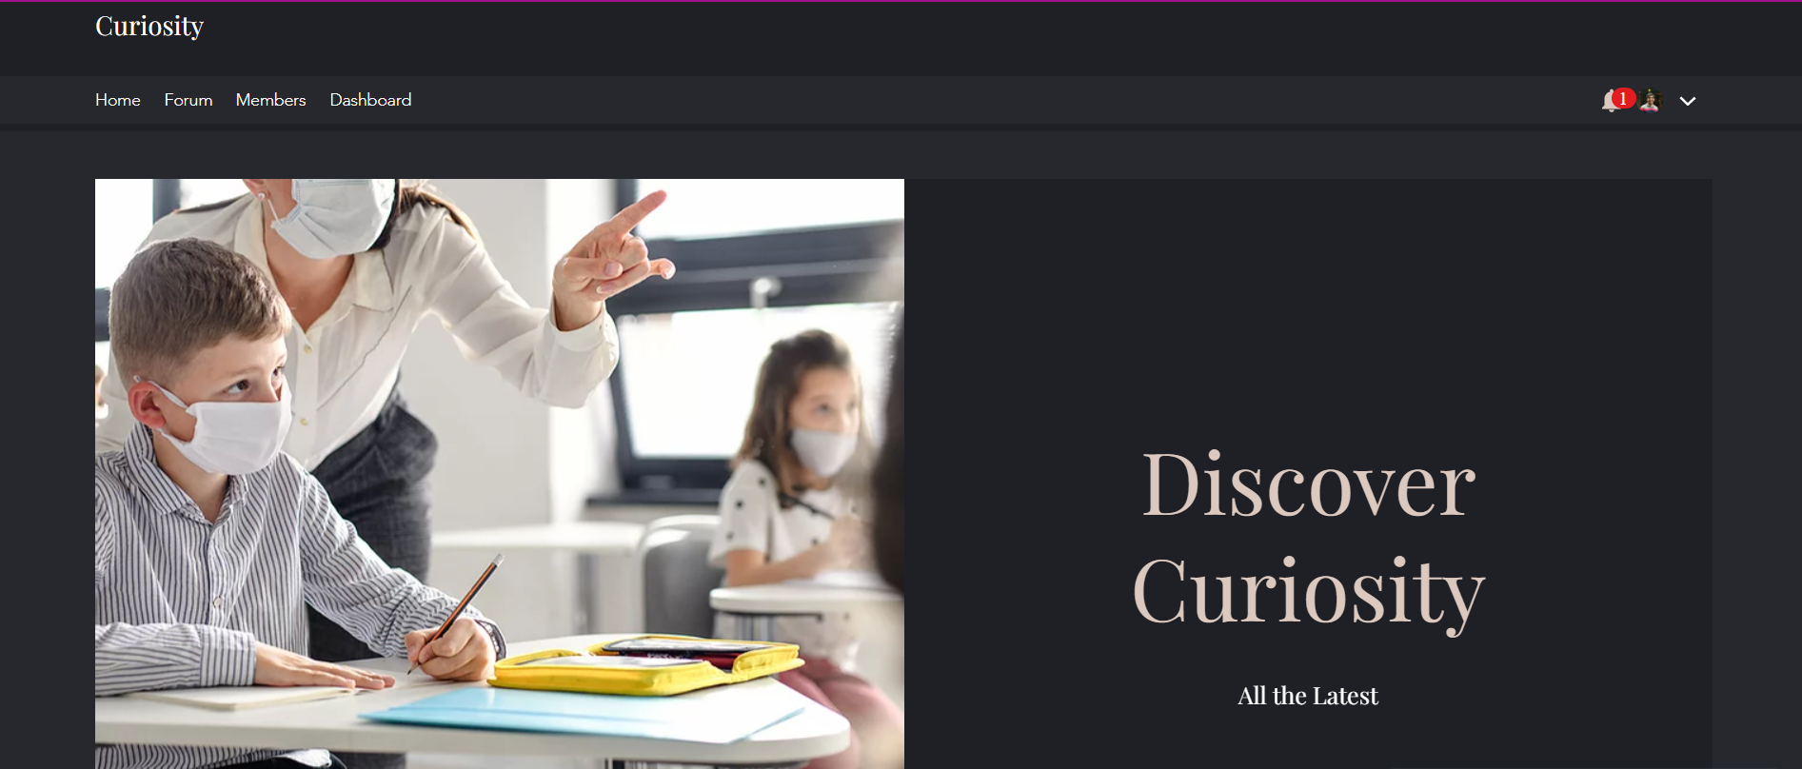
Homepage

Slide 7
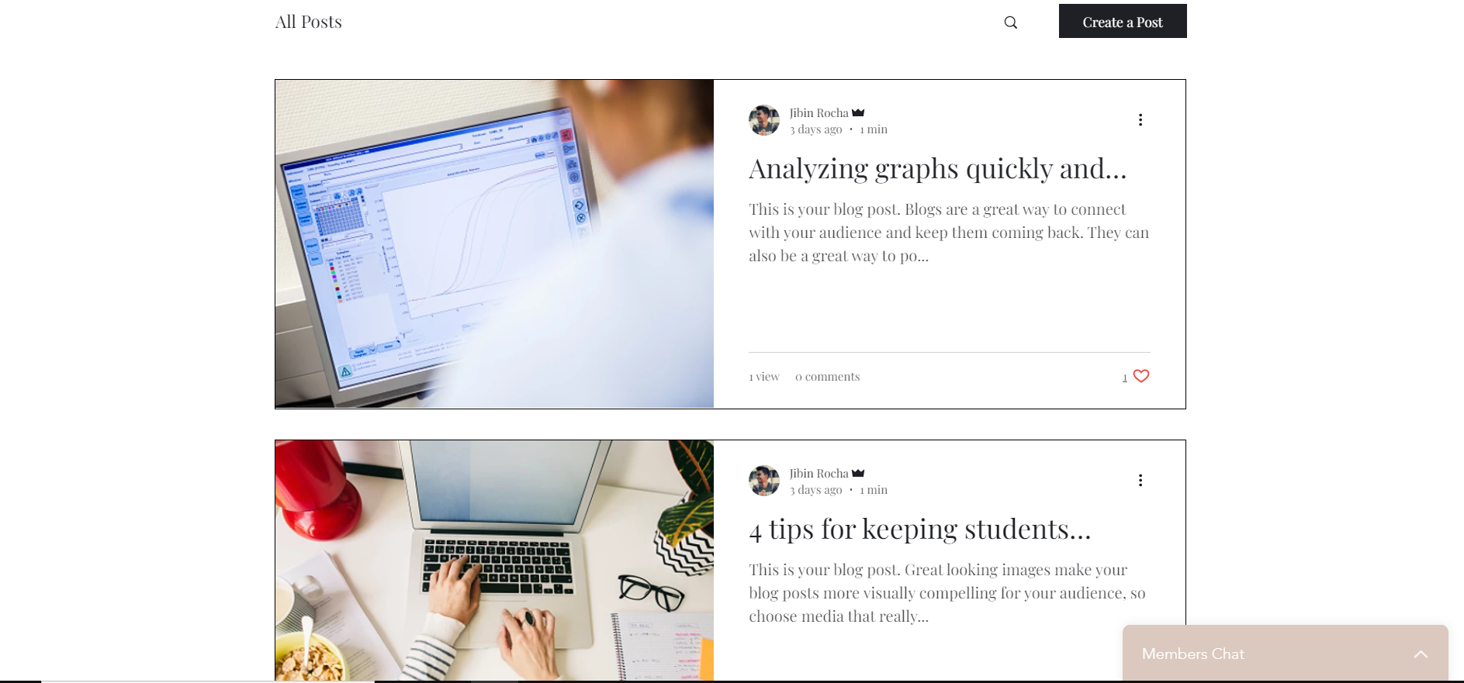
Posts Section
Teachers can add posts for encouraging their students

Slide 8
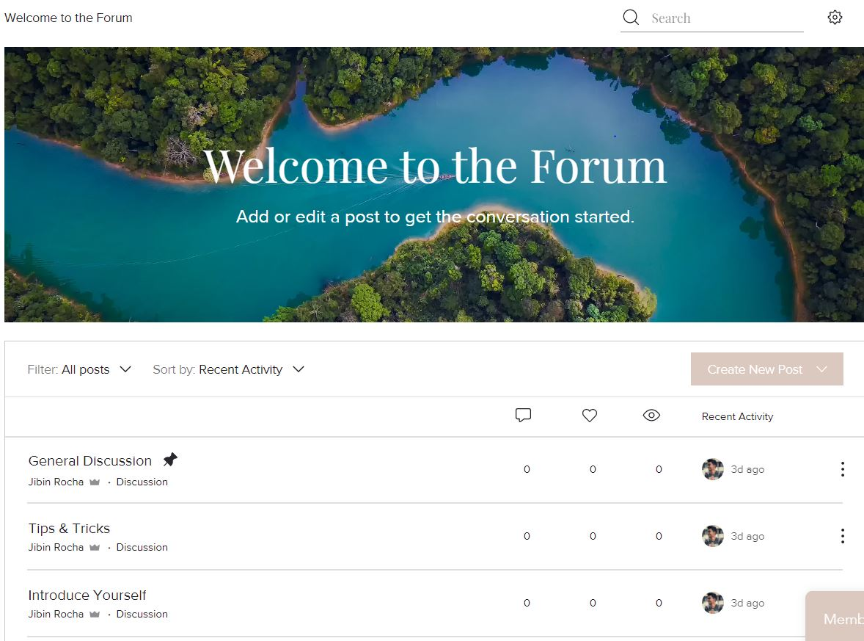
Discussion Forum
A discussion forum is included where students can gather to have discussions about a specific topic and clear their doubts.

Slide 9
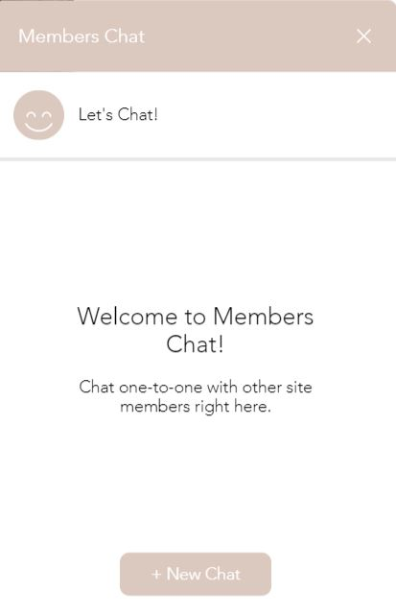
Chatbot
Live text-based conversations

Slide 10
Students can subscribe this website so that they get to know the updates happening in this E-Learning platform

Slide 11
Proposed Features
These are the features which we wanted to implement but could not finish it due to time constraints.
To provide transcripts for videos in the website
To add video-quizzing feature that allows you to insert questions in between the video.
To provide additional coursers on topics like AI, IOT, Machine Learning etc. Students can access these courses if they feel interested.
Gamification features – some simple competitions among the users

Slide 12
Website Link
https://jibinrocha41.wixsite.com/curiosity

Slide 13
THANKYOU
from team
GLITCH

